Slide 1
Alert Monitoring Application
Vignesh Sivanandha Rao
CSC 665 Computer Networks
Fall – 2018

Slide 2
Introduction
What is Alert Monitoring?
The term monitoring is to supervise and detect faults. The main purpose of monitoring is error tracking and help the users in eliminating them.
The major advantage of monitoring is Alerting.
The notification about the monitored failure to the user is known as alerting.
Alerting can be done through sending an email, flash message etc.

Slide 3
Project heads up
The idea of this project is to create a web based alert monitoring application interface which constantly checks the connectivity of a website host or IP. When there is a drop in connection, the application will trigger an email to alert the user.
This information is also logged every minute as the connection trials happen. So when there is an intermittent issue, a user can always come back to check the log file and get the information needed.

Slide 4
inspiration
This idea is an inspiration of alert monitoring applications like Rigor and Gomez (an application from Dynatrace), which sends packets of data from various destinations to make sure that the website is reachable from all locations.

Slide 5
RAW materials used
Operating System – Linux (Ubuntu)
Programming Language – Shell Scripting
Protocol – Simple Mail Transfer Protocol (SMTP)
Operations performed – Ping, Telnet and Traceroute

Slide 6
Functionalities
Internet ping works similar to echo-location. It sends a small packet of information containing ICMP ECHO_REQUEST to the specified host which then sends an ECHO_REPLY packet in return.
Telnet is used to check the open ports. Ports are like doorways for the internet traffic to pass through.
Traceroute is a command which can display the path taken by the packet information sent from our computer. It will list down all the routers it passes through until it reaches the destination. It can also tell you how long each hop from one router to the other has taken.

Slide 7
Functionalities (contd..)
SMTP (Simple Mail Transfer Protocol) is an email server that is responsible for sending and receiving emails. Note: SMTP can only handle txt information.
Binding the operations above, I created a shell script to monitor a website and trigger an email when there is a drop in the connection.
Created a another script file to look for logs which are older than 30 minutes and purge them to conserver memory.

Slide 8
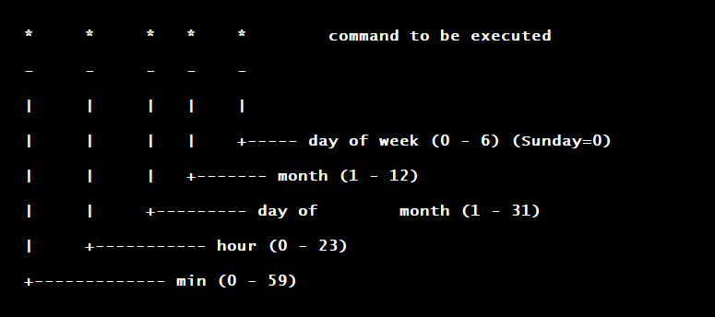
Functionalities (contd..)
Cron is a linux function which is like Task Scheduler in windows. In cron we can schedule a command or a script on our server to start automatically at the specified time and date.

Slide 9
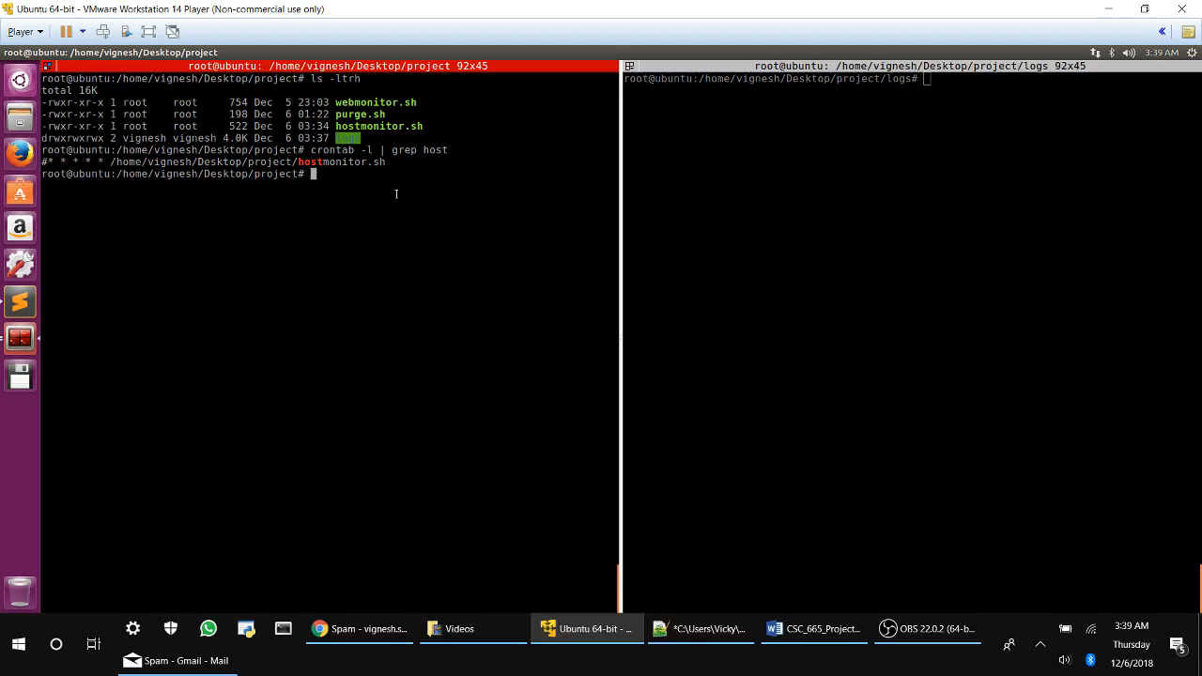

Slide 10
conclusion
This project can not only act as an application but can also be a life saver for production support organizations where the site should be up and running 24x7 and even a single second of downtime can be crucial.

Slide 11
#!/bin/bash echo questions?

